Slide 1
Python Reinforcement
Laptop Dataset
S.Sanjaikumar
Feb DA&DS
DATE- 11-06-25

Slide 2
INTRODUCTION
This project involves Exploratory Data Analysis (EDA) on a laptop dataset with 1303 entries and
12 attributes, including brand, type, screen size, CPU, RAM, GPU, operating system, and price.
The dataset contains both categorical and numerical features, enabling comprehensive statistical
and visual analysis. The goal is to uncover patterns in laptop specifications and understand their
influence on pricing.
Conduct an exploratory data analysis on laptop specs and prices to uncover
key factors that drive pricing.
Clean and preprocess the dataset for reliable statistical insights, examining
features like brand, CPU, RAM, GPU, and more.
Deliver actionable insights to guide consumers toward cost-effective choices
and help businesses tailor their offerings to market demands.

Slide 3
DATA UNDERSTANDING
Data understanding is a vital step in data analysis that examines the dataset’s structure, quality, and key features—such as categorical, numerical, and mixed types—to guide further analysis. It involves identifying missing values, inconsistencies, and outliers, as well as exploring relationships between variables to inform hypothesis and feature engineering. This foundational insight ensures effective data cleaning, transformation, and meaningful analysis outcomes

Slide 4
Dataset Overview
Unnamed: 0
Company
TypeName
Screen Size (Inches)
Weight
RAM
Storage
Operating System
Price

Slide 5
Data Cleaning
Null values checked and handled
Column names standardized
RAM cleaned (numeric GB)
Weight cleaned (numeric kg)

Slide 6
Exploratory Data Analysis
Screen Size Most common: 15.6 inches
RAM Most common: 8 GB or 16 GB
Weight Lightweight laptops dominate certain
brandsPrice Market is skewed towards midrange laptops (₹40k-₹70k)
RAM vs Price Strong positive trend (higher RAM → higher price)

Slide 7
Exploratory Data Analysis (EDA)
Top 5 most expensive laptops
Top 5 lightest laptops
Average price per brandAverage
weight per TypeName

Slide 8
Key Insights
Higher RAM correlates with higher price
Gaming laptops weigh more and cost more
Mac laptops dominate the Ultrabook segment
Price per Kg indicates lightweight premium laptops

Slide 9
Recommendations
Target marketing based on screen size segment
Promote lightweight laptops in premium segment
Focus on mid-range laptops (highest demand)

Slide 10
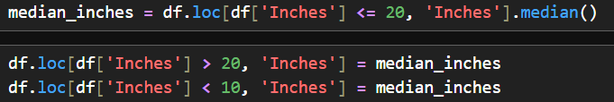
DESCRIPTIVE STATISTICS

Slide 11
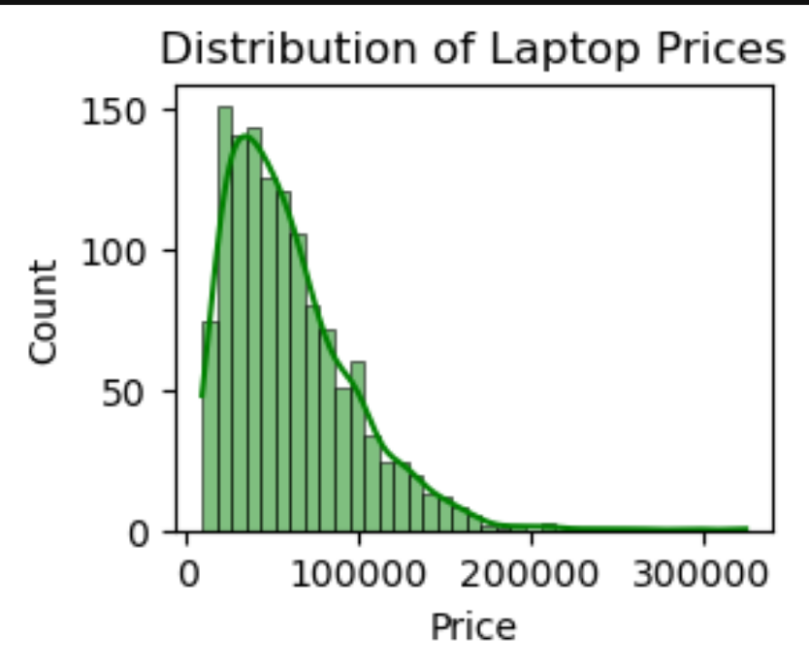
UNIVARIATE ANALYSIS

Slide 12
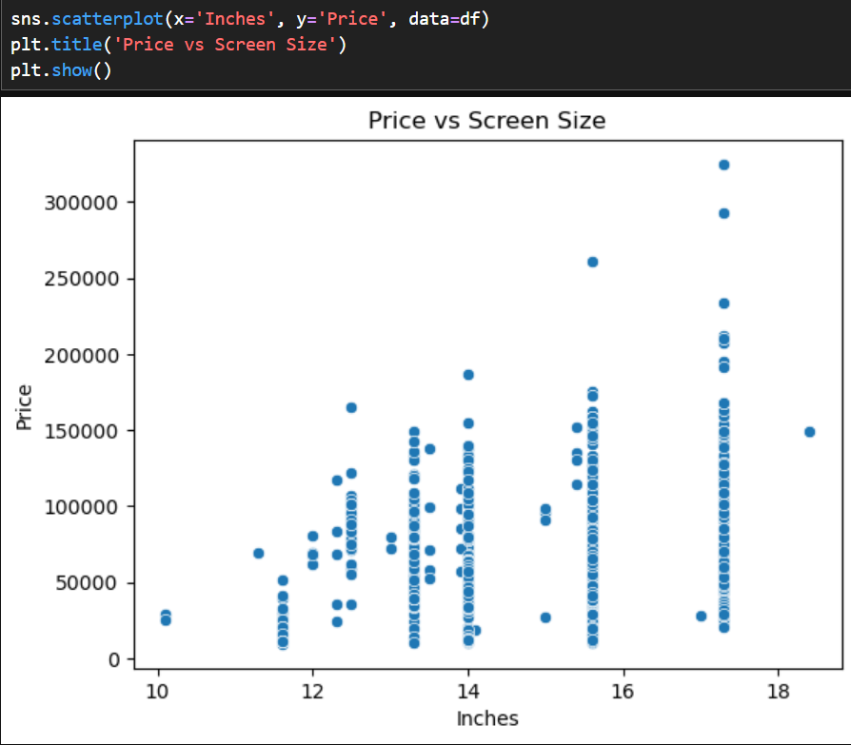
SCATTER PLOT ANALYSIS

Slide 13
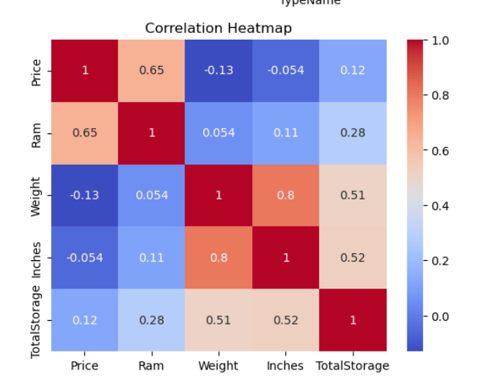
CORRELATION HEATMAP

Slide 14
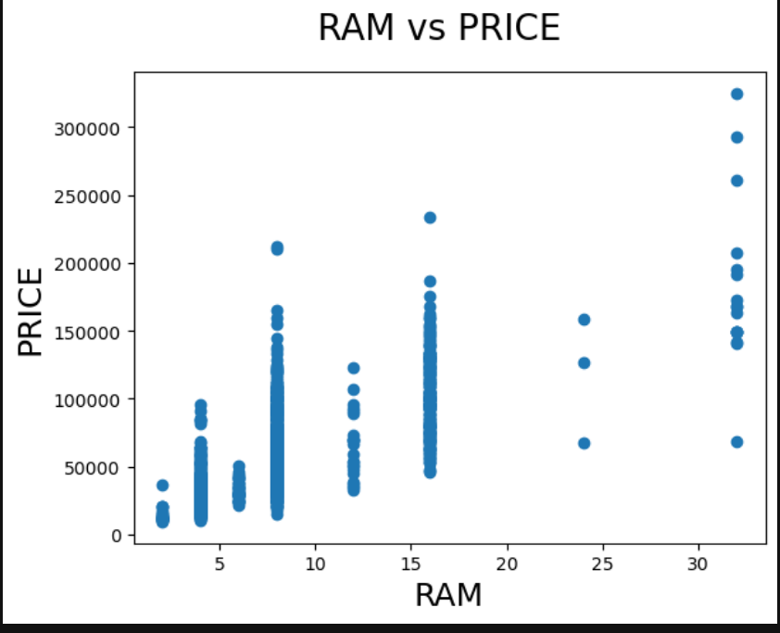
RAM VS PRICE

Slide 15
CONCLUSION
The mid-range segment dominates the market (₹40k to ₹70k laptops).
15.6-inch screen size is the most popular among laptops.
The most common RAM size is 8 GB, suitable for most users.
Lightweight laptops (<2 kg) are highly preferred in the Ultrabook and Notebook segments

